Slide 1
TI Innovation Robot
Senior Design II
Final Presentation
December 5, 2014

Slide 2
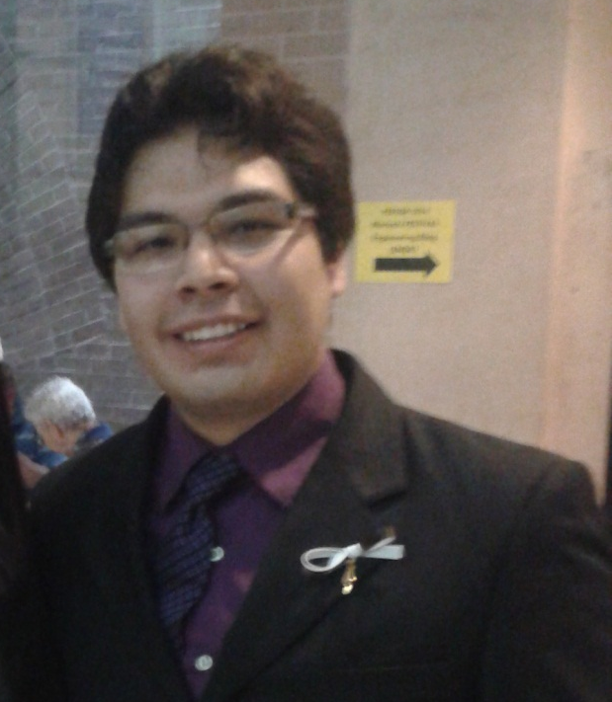
Eder F. Torres
Instructor: Dr. Li
Advisors: Dr. Dong
Dr. Chu

Slide 3
Contents:
Introduction
Problem Statement
Need Statement
Objective
Requirements Specification
Marketing Requirements
Engineering Requirements
Constraints
Expected Cost
System Design
PCB Design
Test Results
Final Prototype and Demo Video
Summary

Slide 4
Introduction
Goal: Design a robot that can be controlled remotely by a human with little experience in very short time.

Slide 5
Problem Statements: Need Statement
On time of disaster, people are sent to rescue, sometimes these rescuers lose their life or get severely injured.
A device is needed to be sent instead of a human life for survivors search or hazardous procedures.

Slide 6
Problem Statements: Objective
Minimize the number of human lives sent to dangerous places.
Affordable for government and private rescuing companies (So many robots can be sold and many of them could be used)
Easy to use so no special training is needed.
Robust (water and fire resistant)

Slide 7
Marketing Requirements
TI Innovation Robot
Performance 50%
Aesthetics 1%
Easy-To-Use 29%
Safety 20%
Battery Life 33.33%
Video Quality 33.33%
Connectivity 33.33%
Case Design 100%
Real-time Response 50%
Common Control type 50%
Doesn’t cause damage 50%
Ergonomic Controller 50%

Slide 8
Engineering Requirements
Should be able to be driven from at least 50 miles away
Should be able to connect via Wi-Fi
Should be able to deliver video in real time
Batteries should last 4 hours

Slide 9
Constraints
Economic:
Product should cost less than $2000
All terrain:
Should be able to move through all kind of surfaces
Easy to Use:
Any person that has used a computer for any use should be able to drive it.

Slide 10
Cost: cont..
Device | Quantity | Retail Cost | Invested money | Paid by
Robotic arm | 1 | $ 55.35 | $55.35 | EE Dept.
Linksys e2500 | 1 | $79.99 | $30.00 | Eder
Power LED | 4 | $3.00 | $2.49 | Eder
ISO7220 | 4 | $6.00 | $0.00 | TI
Switches | 2 | $3.99 | $3.99 | Eder
Aluminum Casing | 1 | $22.96 | $22.96 | Eder
Motors | 4 | $39.95 | $159.80 | EE Dept.
Switching Regulator1 | 1 | $15.04 | $15.04 | Eder
Switching Regulator2 | 1 | $20.31 | $20.31 | Eder
Switching Regulator3 | 3 | $3.22 | $9.66 | Eder
BeagleBone Black | 1 | $50.00 | $50.00 | EE dept.

Slide 11
Cost
Device | Quantity | Retail Cost | Invested money | Sponsored by
Tire Pair | 2 | $19.95 | $39.90 | EE Dept.
PIC18F46k22 | 2 | $4.47 | $0.00 | Microchip
MSP430G2553 | 1 | $3.00 | $0.00 | TI
Li-Po Cells | 6 | $19.35 | $116.10 | EE Dept.
H-Bridges | 4 | 12.76 | $0.00 | TI
Gear motor Metal Bracket | 2 | $7.95 | $15.90 | EE Dept.
Aluminum Hub | 2 | $7.95 | $15.90 | EE Dept.
Cam-Pan-Servo | 2 | $35.49 | $70.98 | EE Dept.
LM629 | 4 | $50.00 | $0.00 | TI
Aluminum sheet | 1 | $14.28 | $14.28 | Eder
Logitech c920 | 1 | $100 | $60 | IEEE
 |  | Total | $702.66

Slide 12
System Design: Level 0
Webcam
Video
TI Robot
Keystrokes through Wi-Fi
Movement

Slide 13
System Design: Level 1
Arm, Camera-pan Controller
Servos
Keystrokes
Repeater
Bridge
Signal distributer
Motor Controller
Motors
Signal distributer
Camera
Data
Repeater
Bridge
Video Stream

Slide 14
System Design: Level 2
Microprocessor receives commands through SSH and sends the keystrokes through UART1
UART1 received by PIC MCU send commands through SPI and UART
Keystrokes sent through SSH
Repeater bridge converts Wi-Fi signal to Ethernet signal
Motors
H-Bridges
PIC MCU sends Command to LM629s
Servos
MSP430 MCU sends pulses for servos

Slide 15
System Design: Level 2
Web Camera
(C920)
Microprocessor video through USB, repackage for RTP stream with UDP sink through GSTREAMER
Linux computer streams video
Repeater bridge converts Ethernet signal to Wi-Fi signal

Slide 16
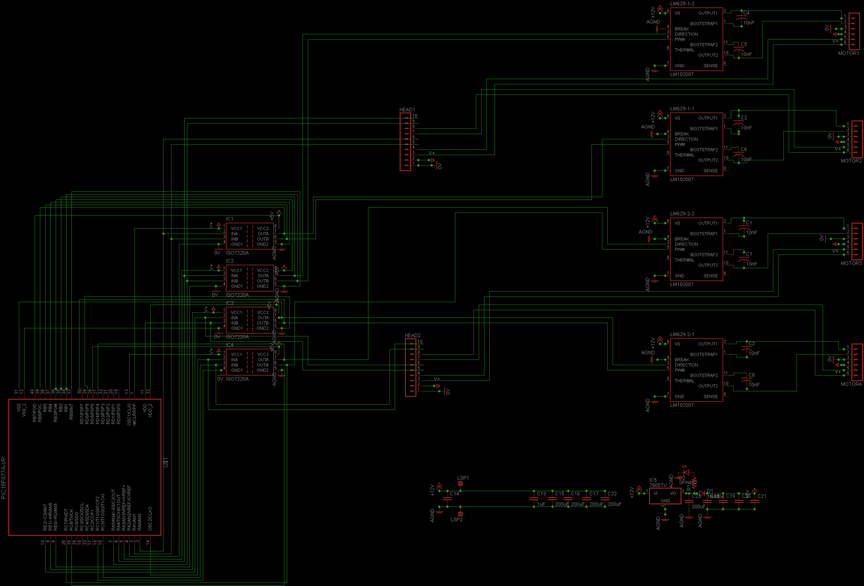
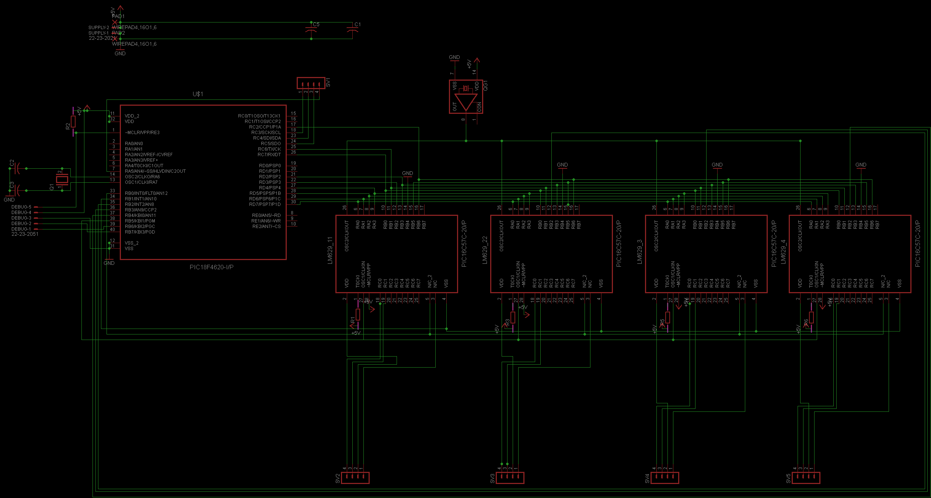
System Design: Level 3

Slide 17
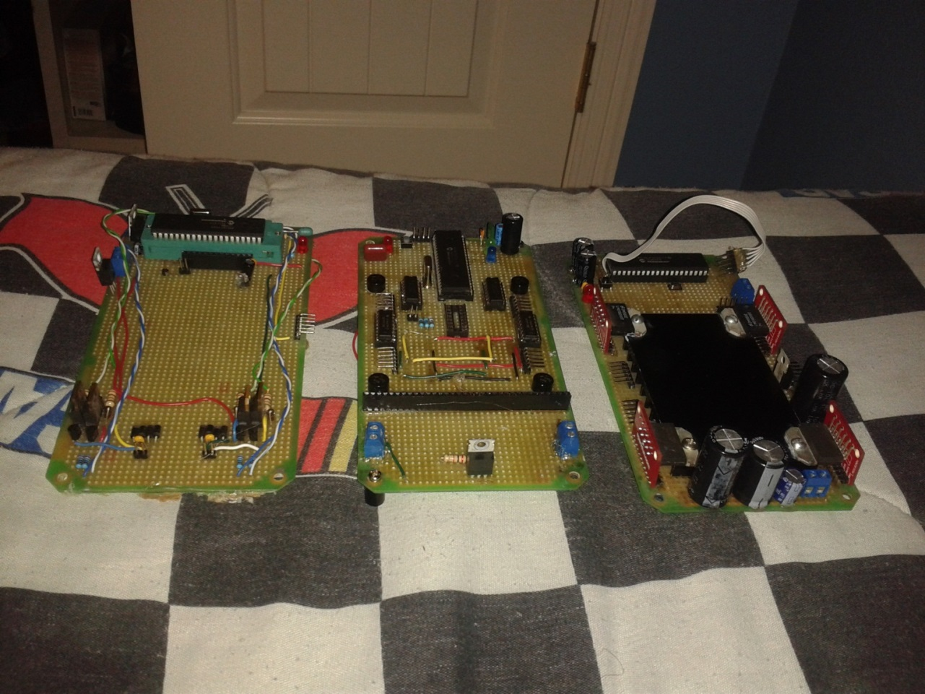
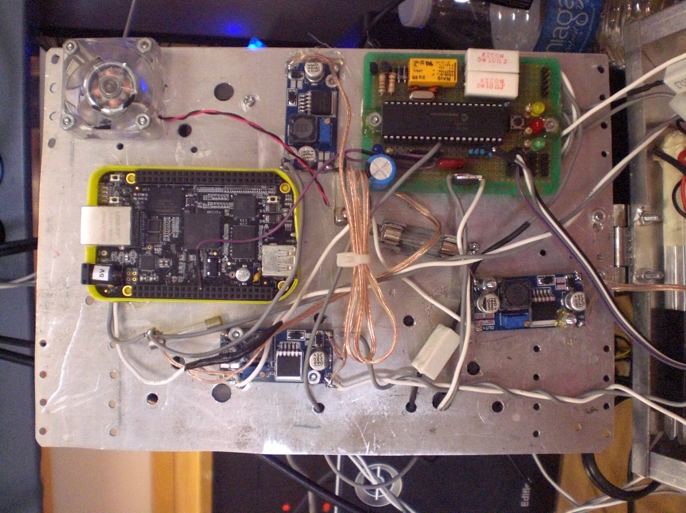
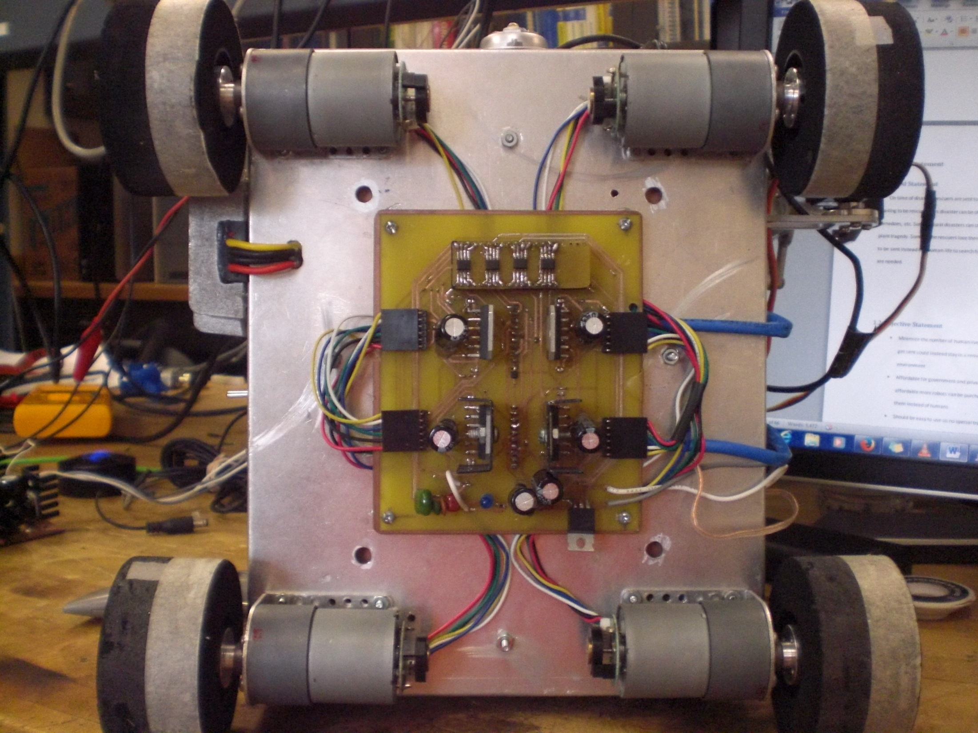
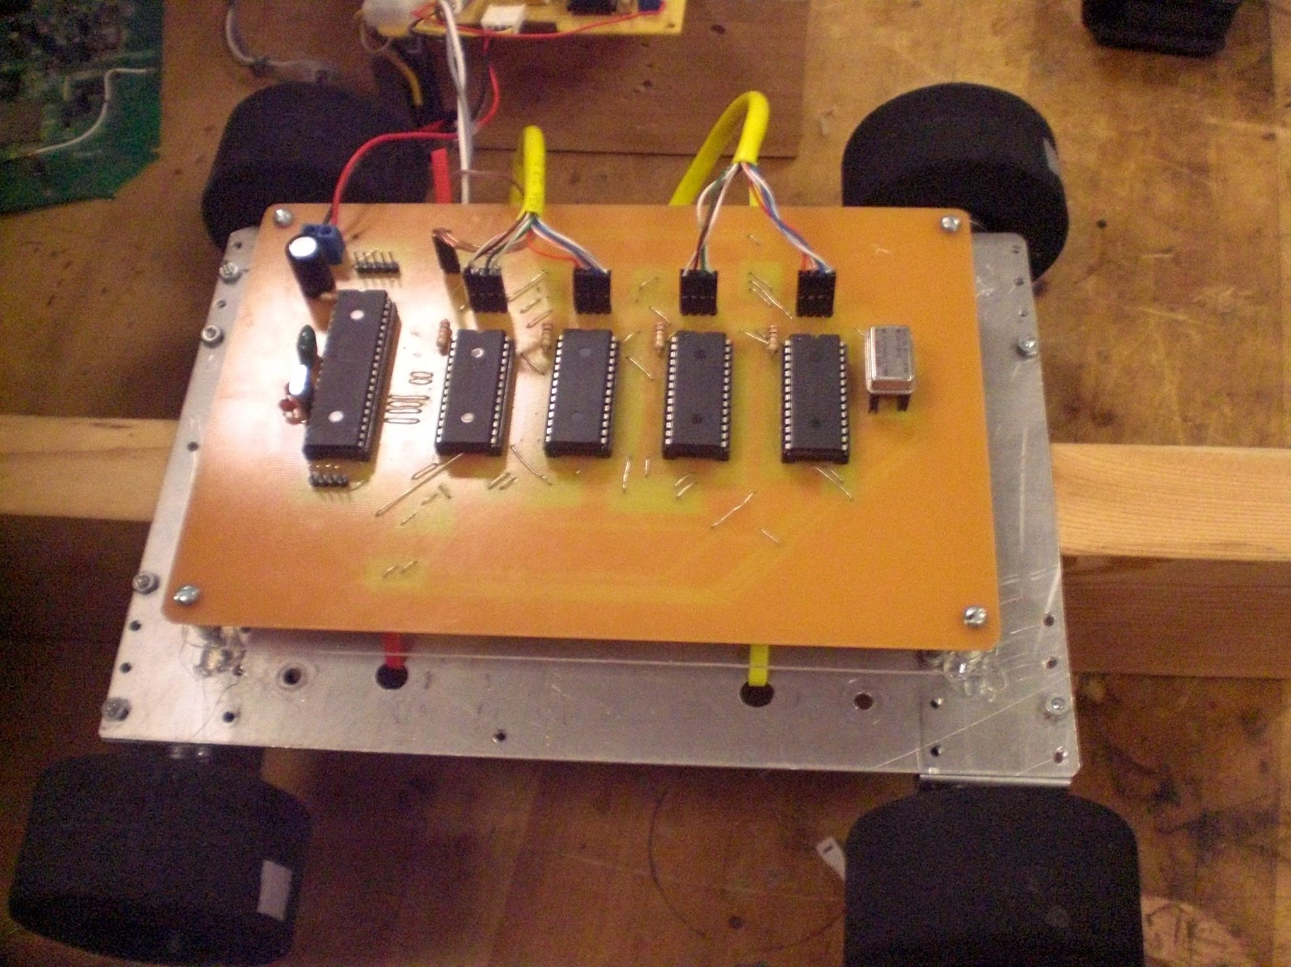
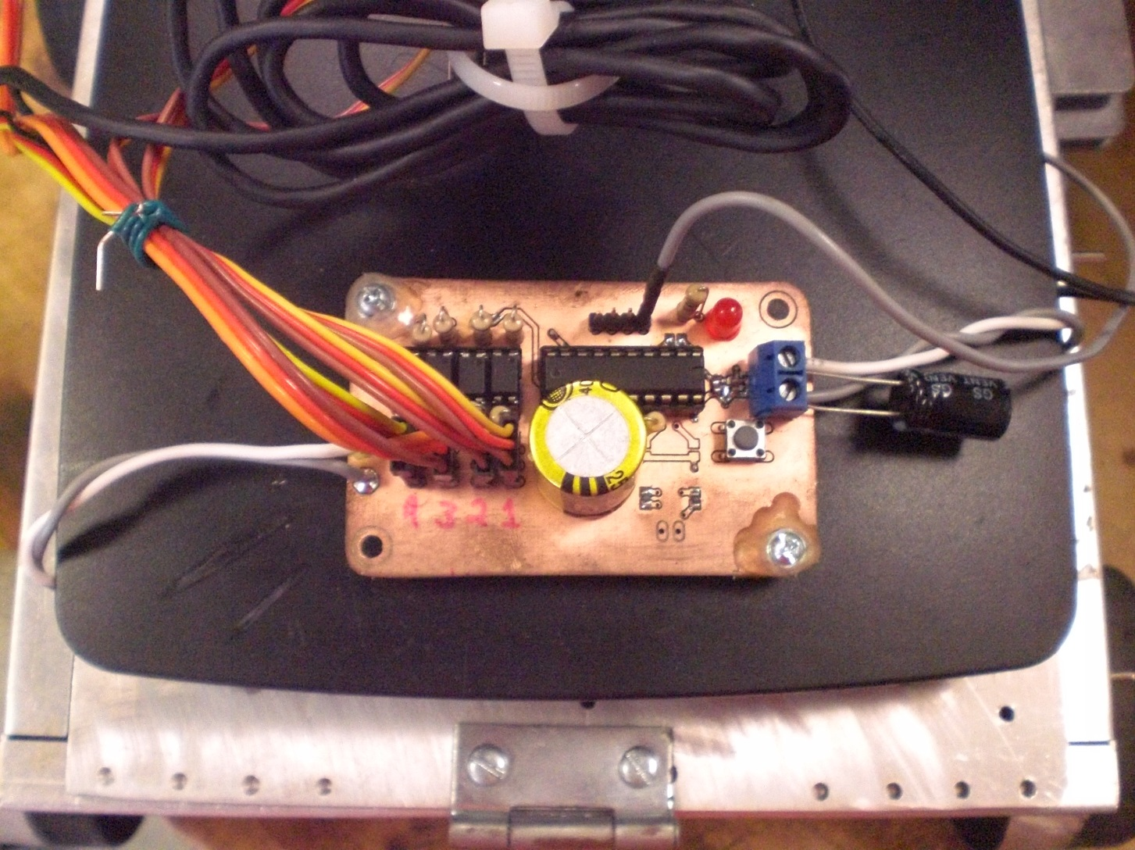
PCB Design:

Slide 18
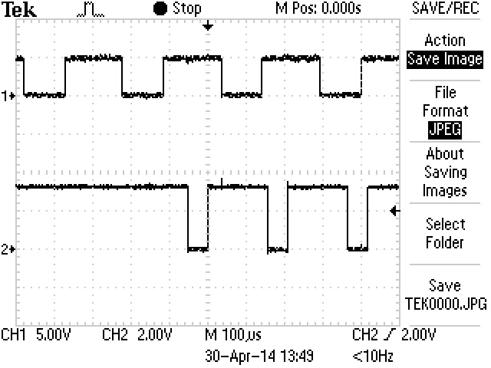

PIC18F46K22 received char. PWM signal output for LM629
Input: character through USART
Output: PWM signal (magnitude) High/low signal (sign)
PWM signal
Serial input Character

Slide 19
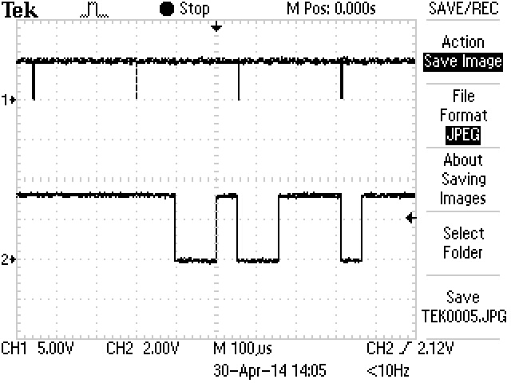
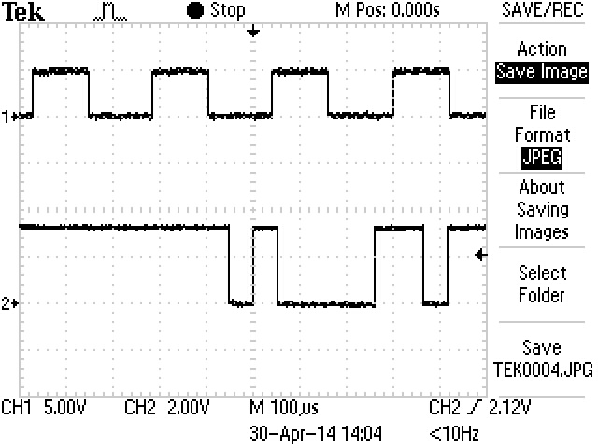
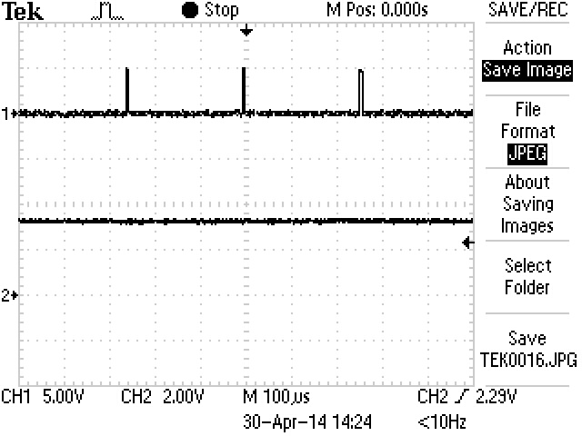
“r” character input
“a” character input
PWM 1 and PWM 2 modules responded the same with the same inputs
No character as input

Slide 20
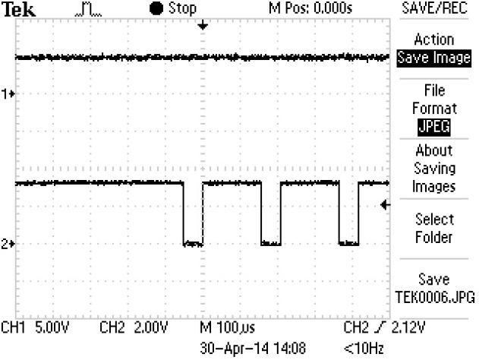
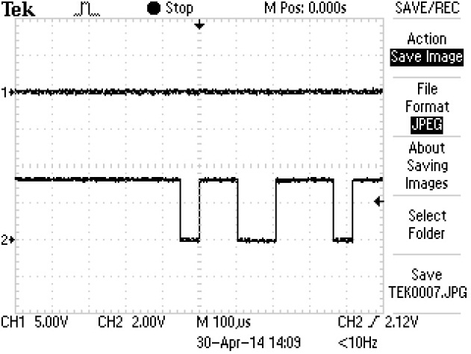
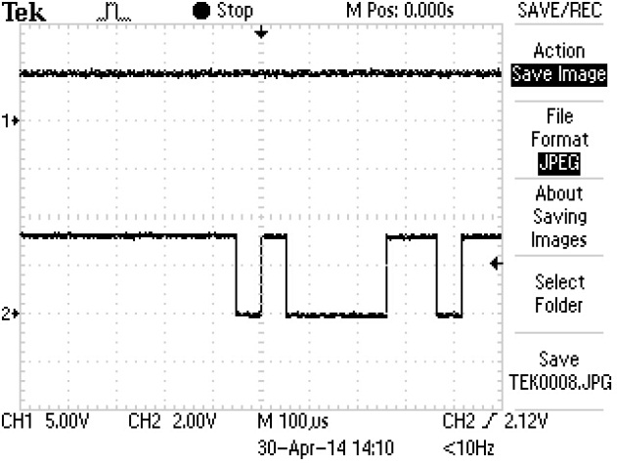
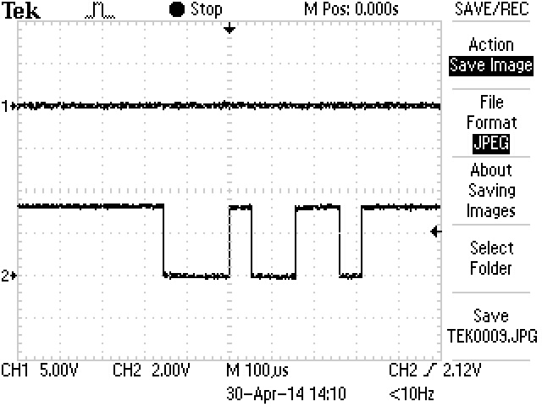
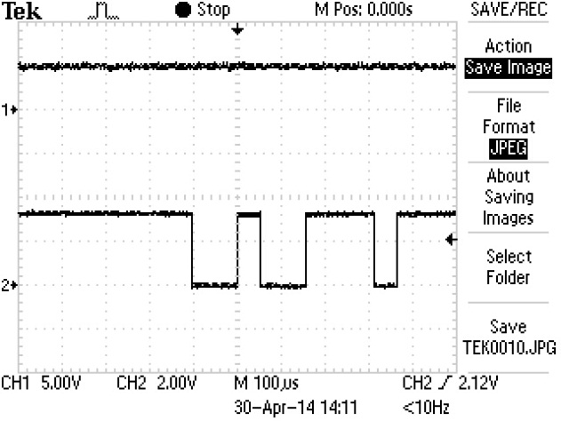
Right motors LM629 Sign output
w
s
a
d
r

Slide 21
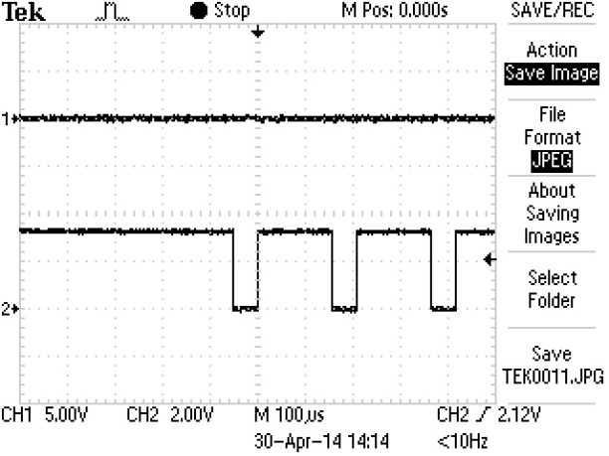
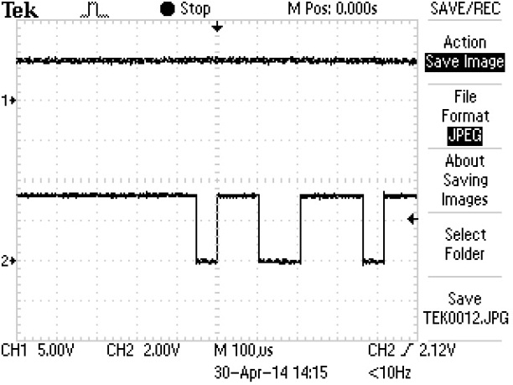
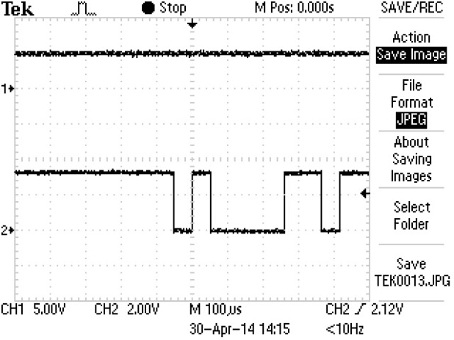
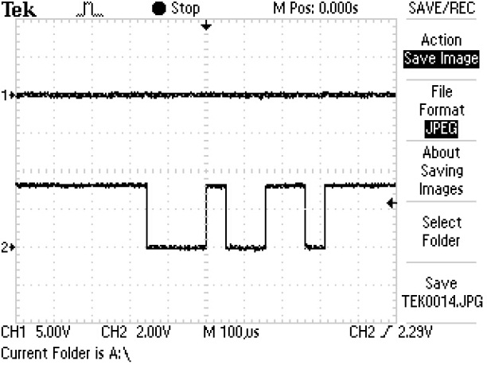
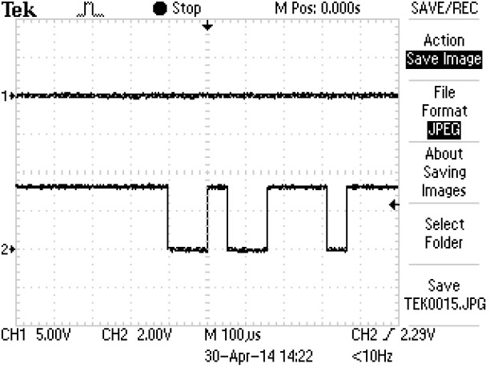
Left Motors LM629 Sign Output
w
a
s
s
r

Slide 22
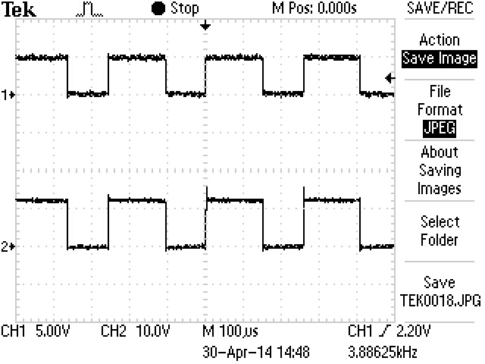
H-Bridges
Input: PWM signal and high/low from MCU
Output: PWM signal
Input (5.00V per div)
Output(10.00V per div)

Slide 23

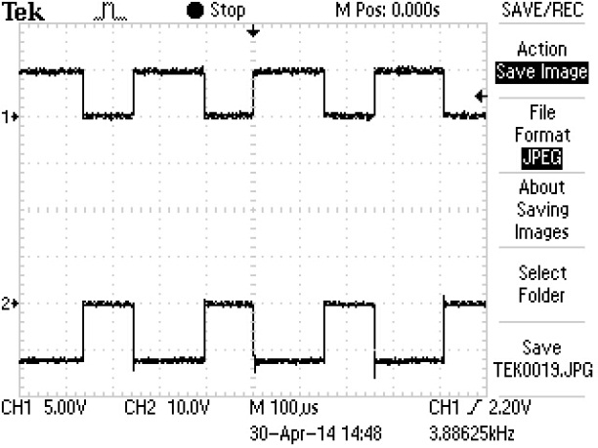
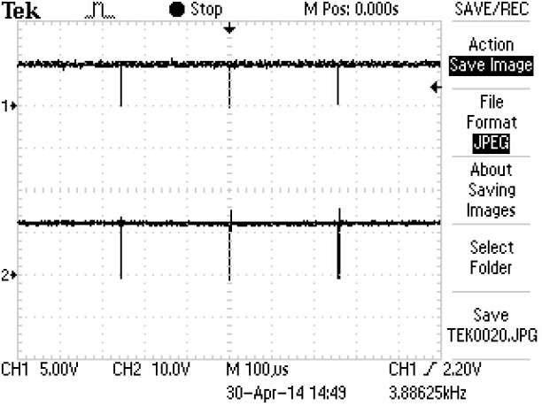
Right side H-Bridges
w
s
r

Slide 24


Left Side bridges
s
w

Slide 25
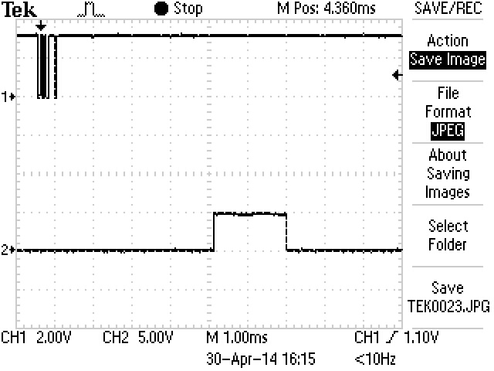
MSP430g2553
Input: Character through the serial port
Outputs: 50Hz wave for servos
Input character
Output wave

Slide 26

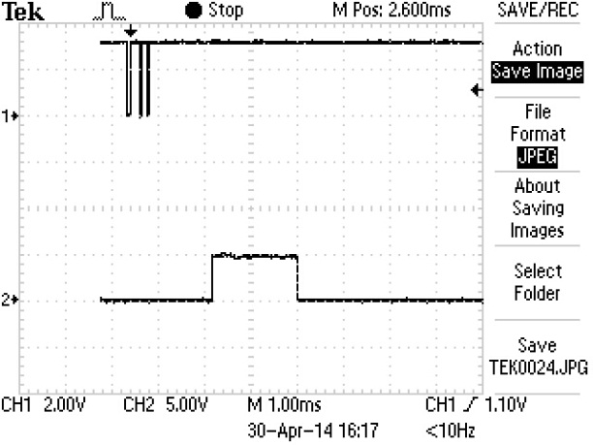
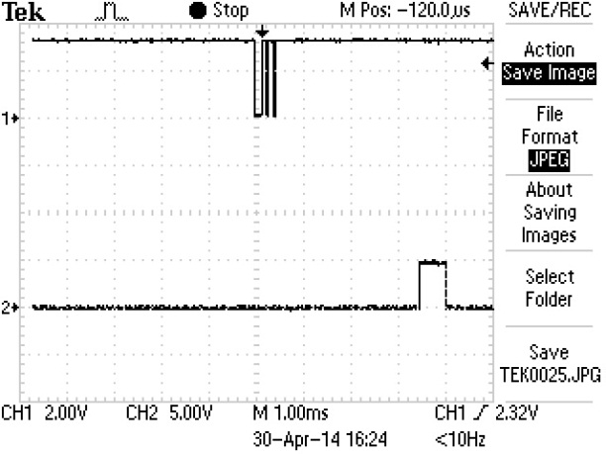
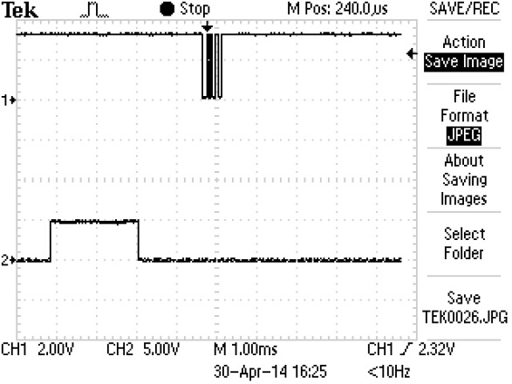
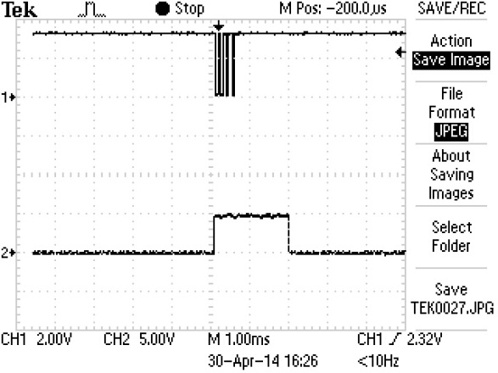
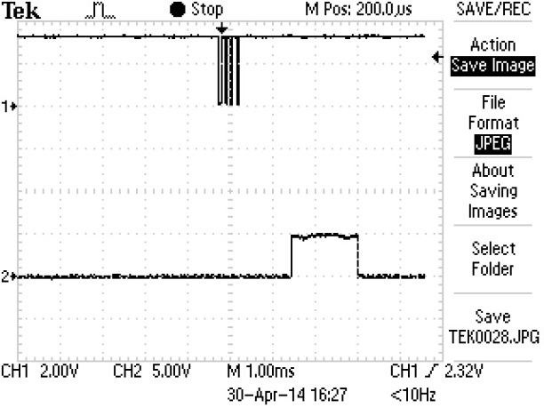
Servos for arm & camera
Char “u” for camera Char “o” for camera Char “l”

Slide 27
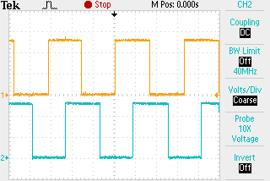
Quadrature Encoder Signals

Slide 28
Motors

Slide 29
Motors

Slide 30
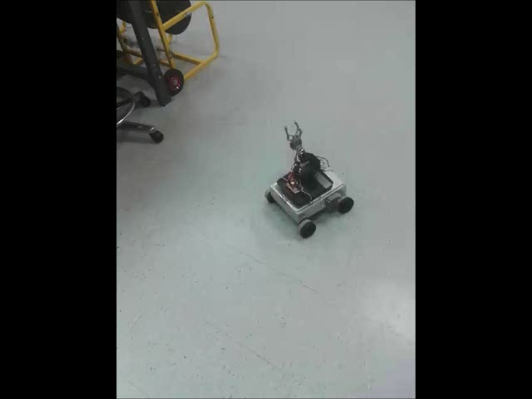
Demo Video

Slide 31
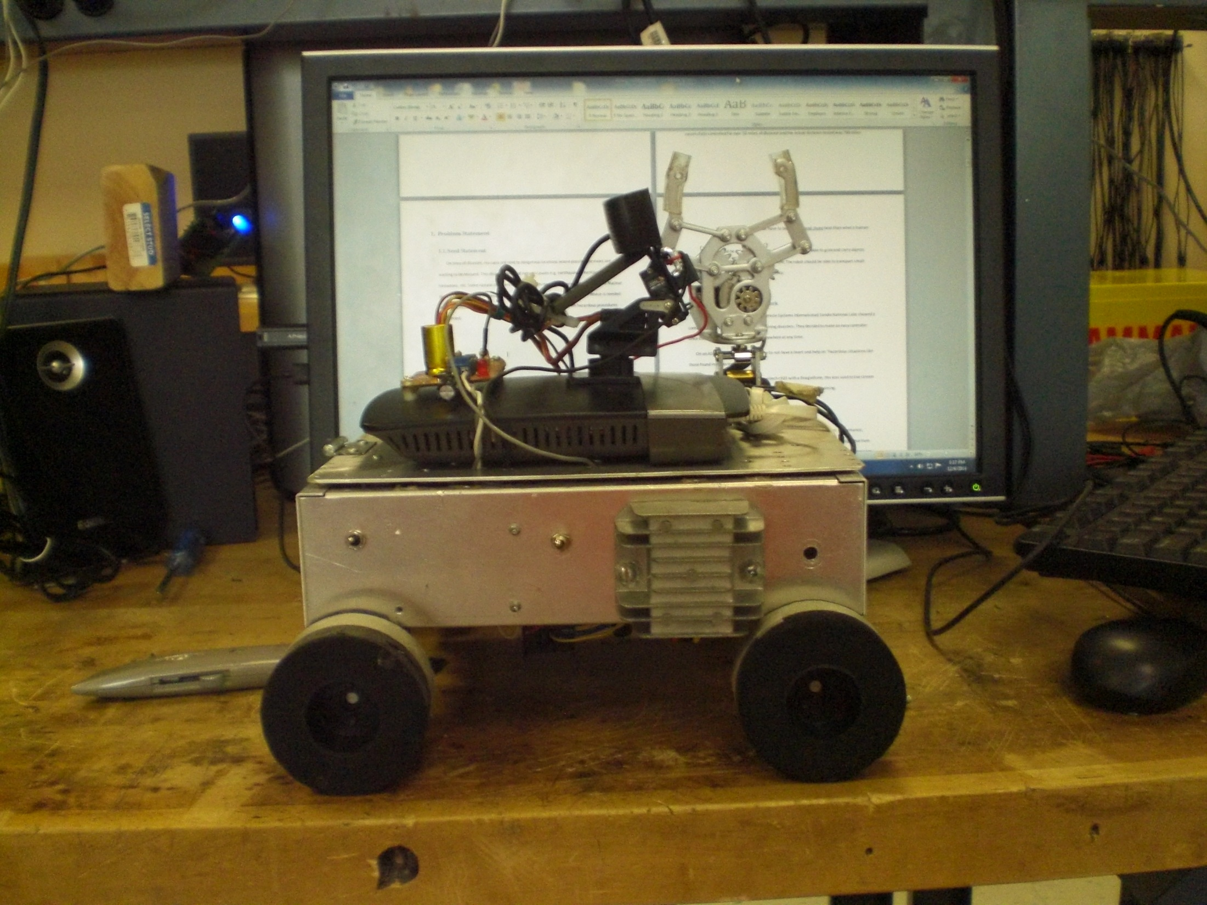

Slide 32
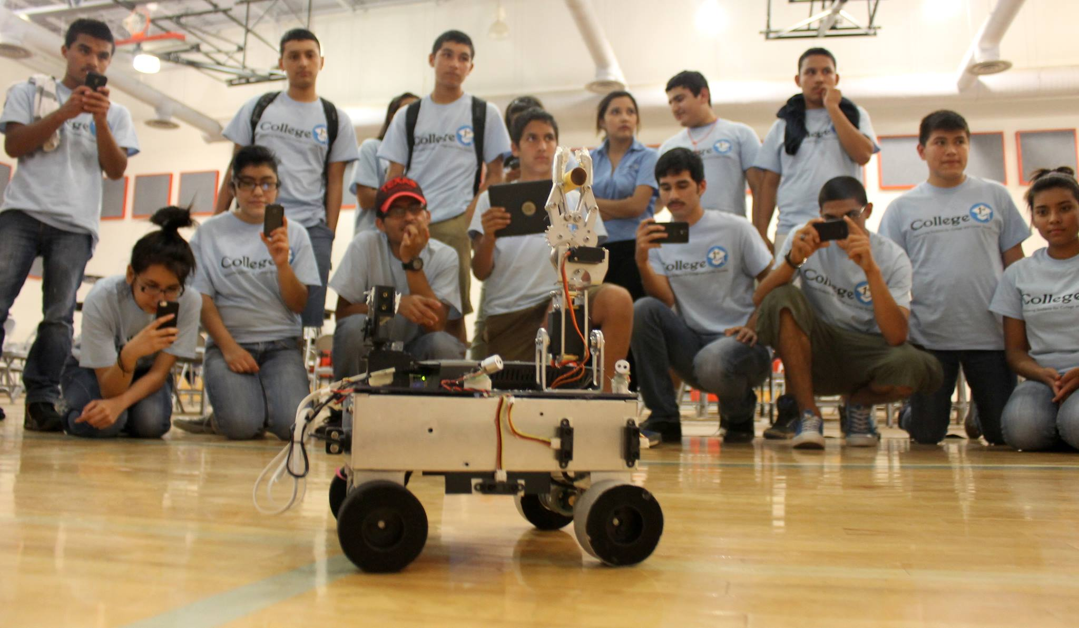
Easy to Use

Slide 33
Summary
The robot prototype is working.
All individual systems are working.
The robot can be driven from any place that has internet (if the robot is located at a place with Wi-Fi connection)
The robot is easy to drive (Tested by high school kids)

Slide 34
References
http://www.armhf.com/beaglebone-black-serial-uart-device-tree-overlays-for-ubuntu-and-debian-wheezy-tty01-tty02-tty04-tty05-dtbo-files/
http://www.oz9aec.net/index.php/beaglebone/476-turning-the-beaglebone-into-a-high-definition-ip-camera
http://www.ti.com/product/lmd18200
http://www.microchip.com/wwwproducts/Devices.aspx?dDocName=en010300
http://www.ti.com/product/iso721
http://www.batteryspace.com/polymerli-ioncells.aspx

Slide 35
Questions:

